Slide 1
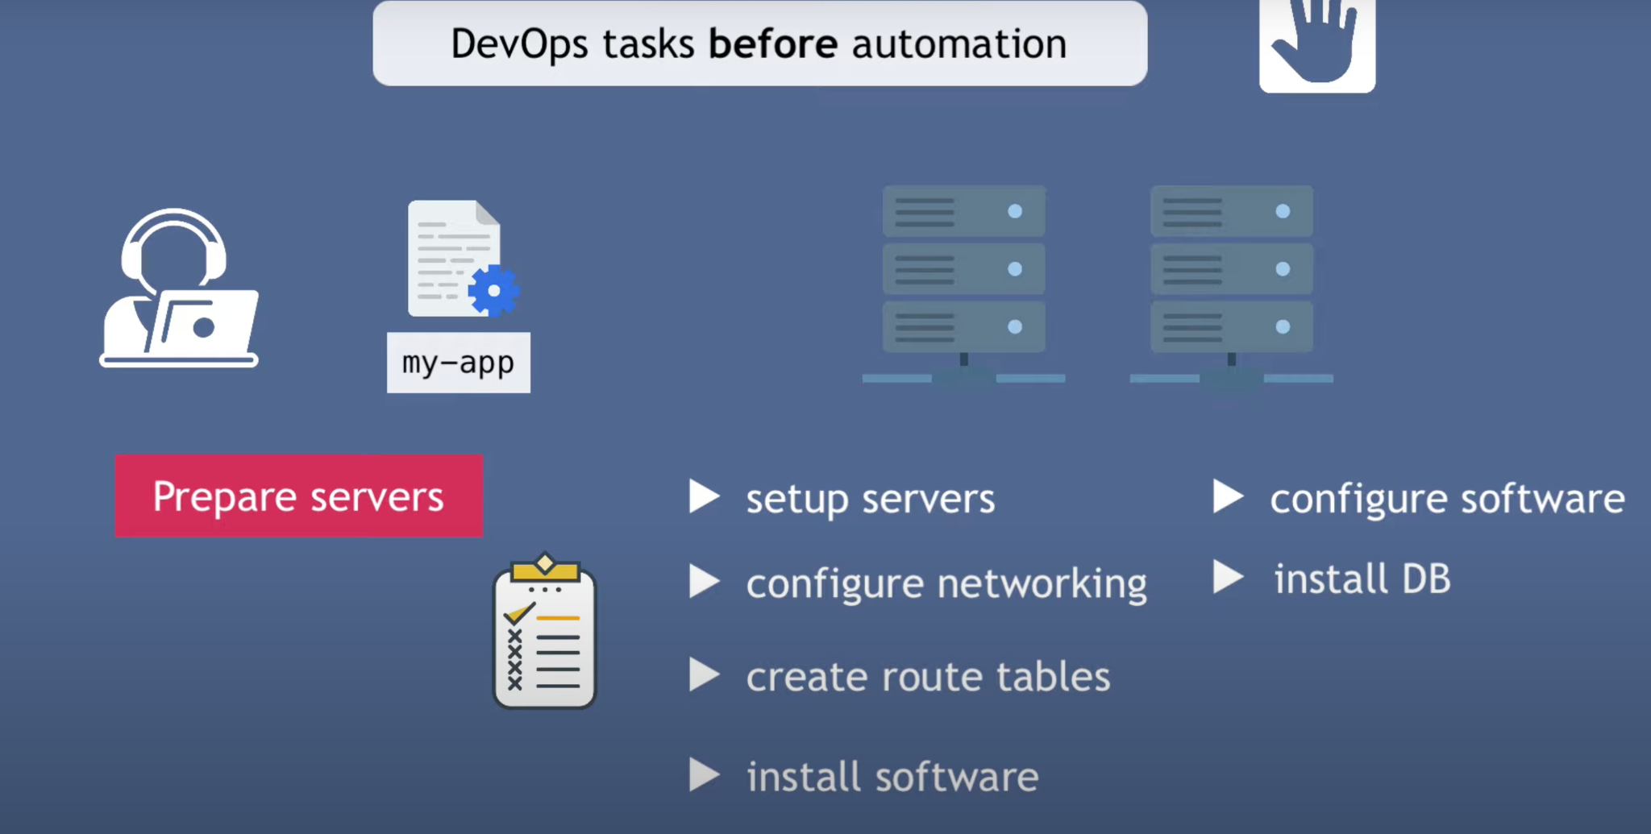
Why Infra as Code

Slide 2
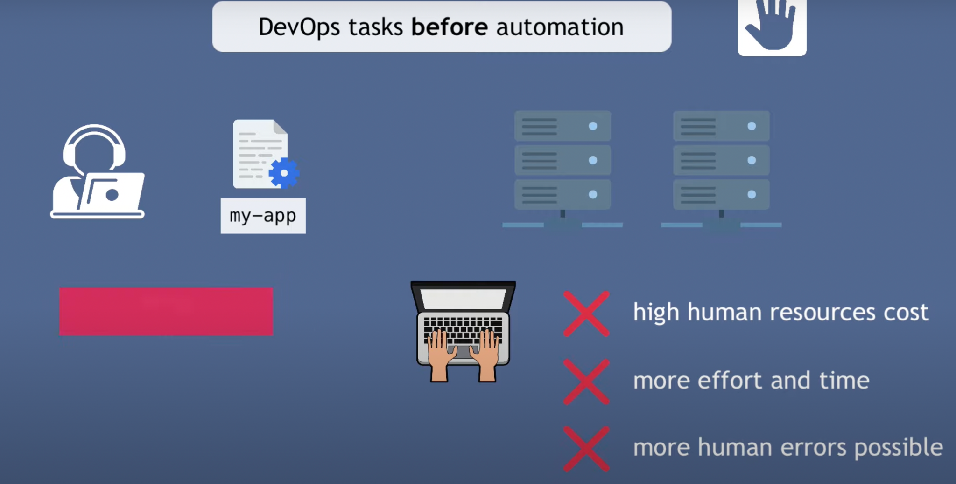

Slide 3
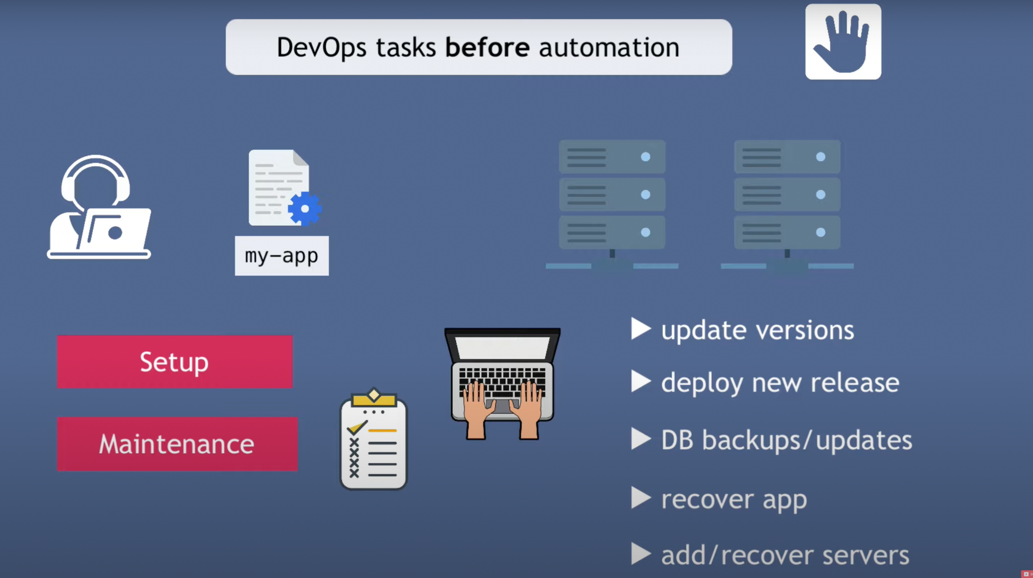

Slide 4
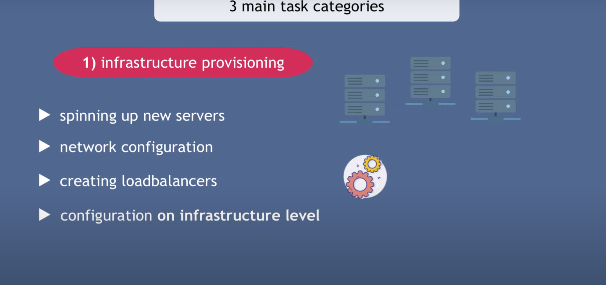

Slide 5


Slide 6


Slide 8
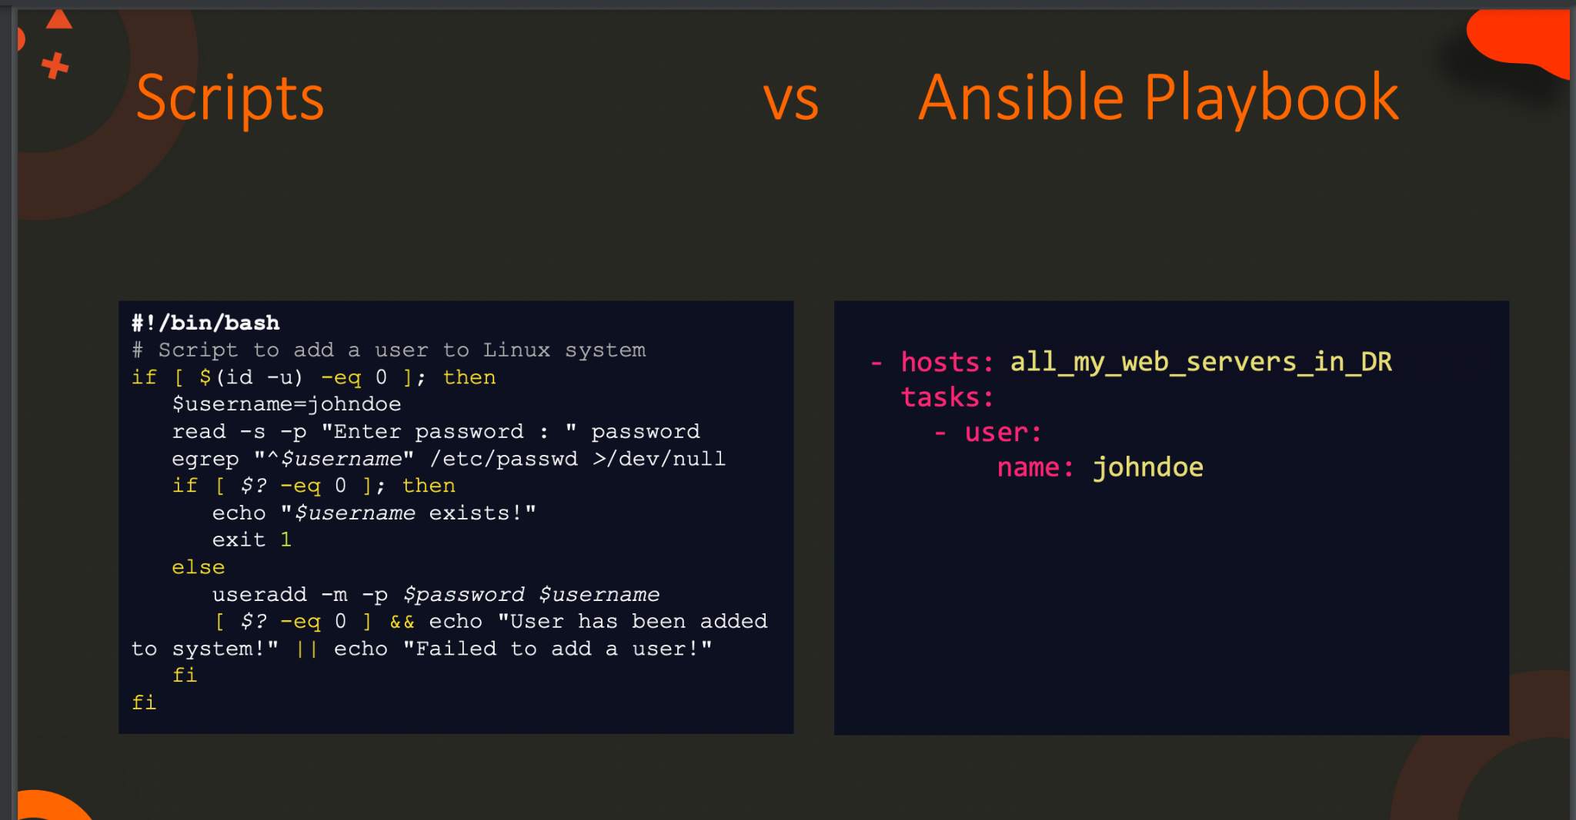

Slide 9
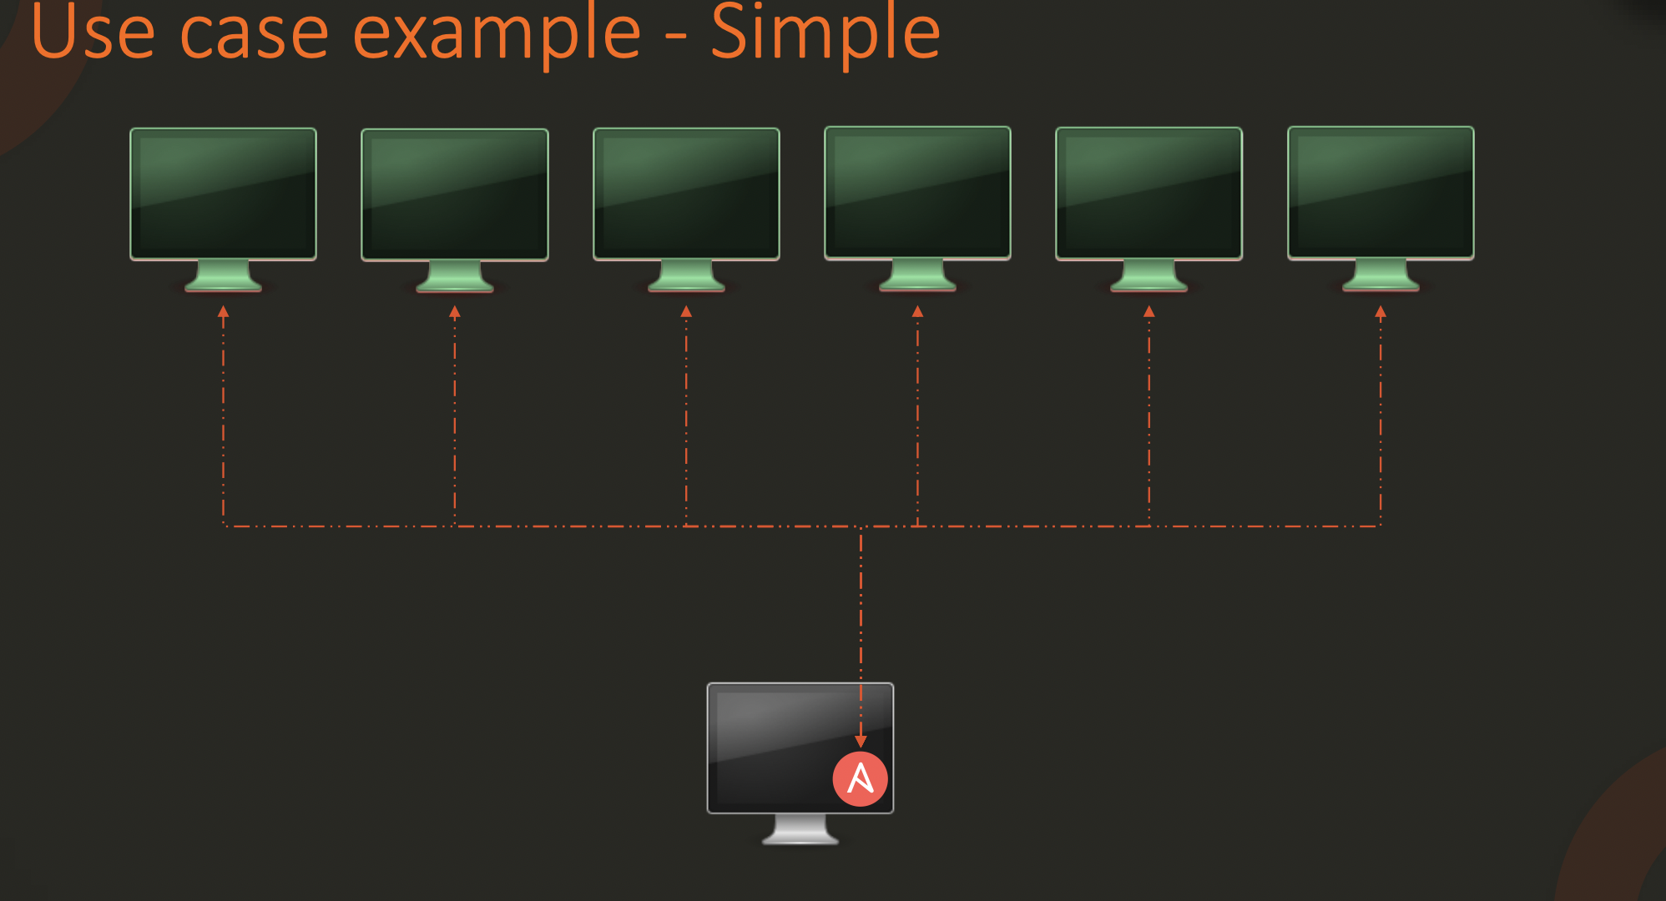

Slide 10
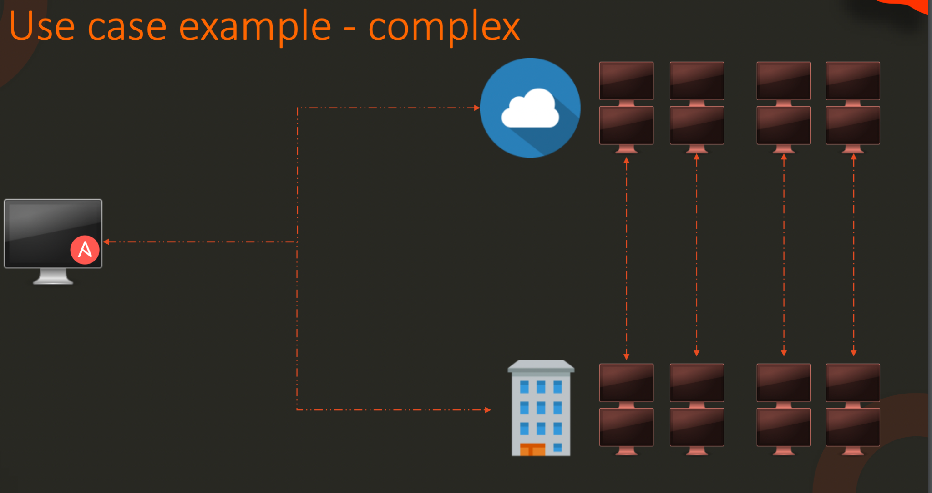

Slide 11
Ansible Documentation
https://docs.ansible.com/

Slide 12
YAML
The yaml file is used to represent the configuration data

Slide 13
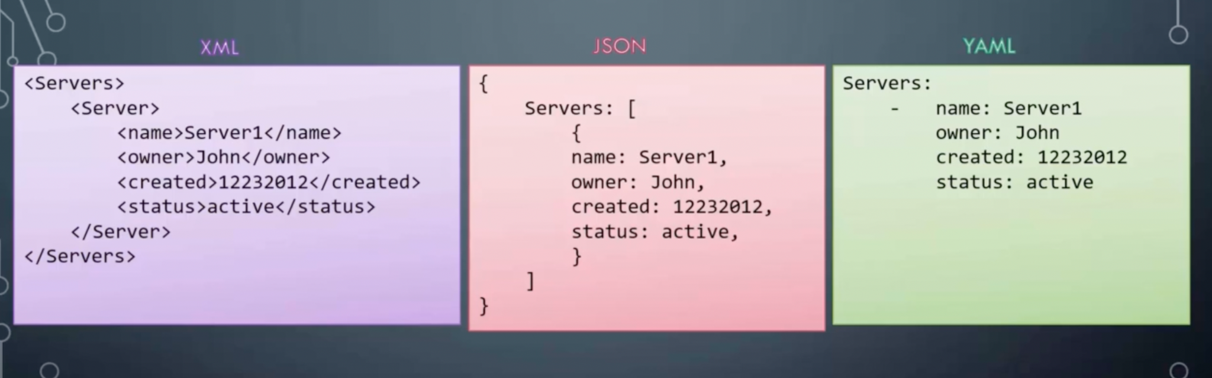

Slide 14
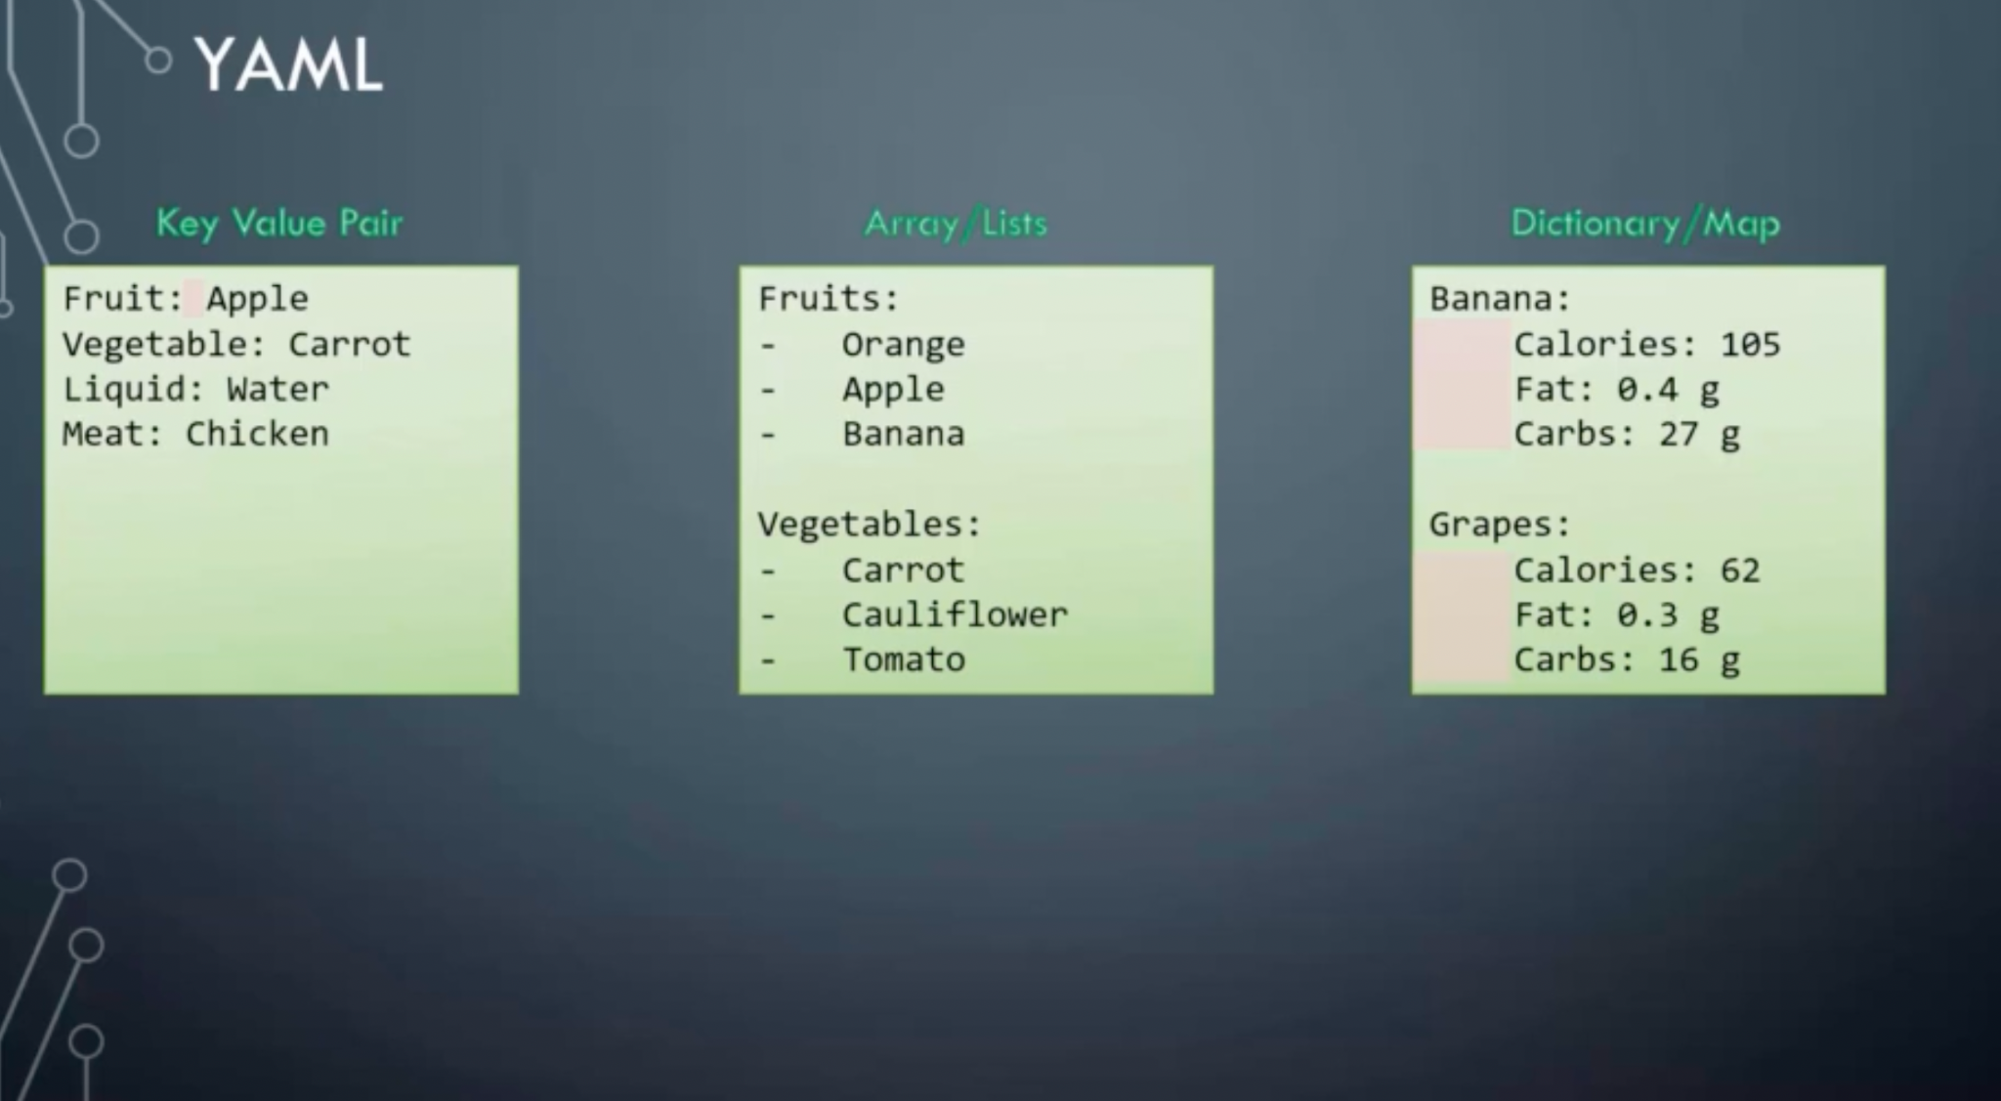

Slide 15
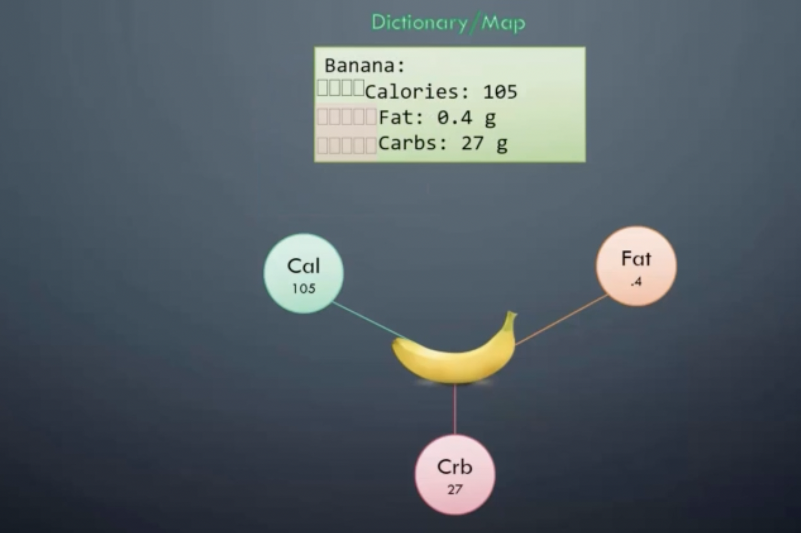

Slide 16
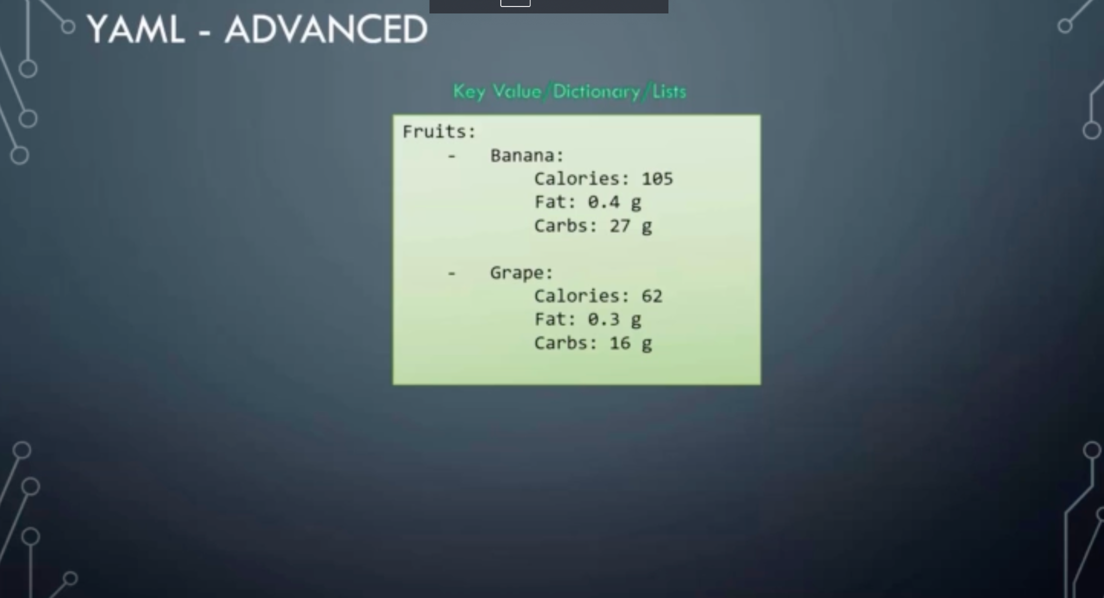

Slide 17
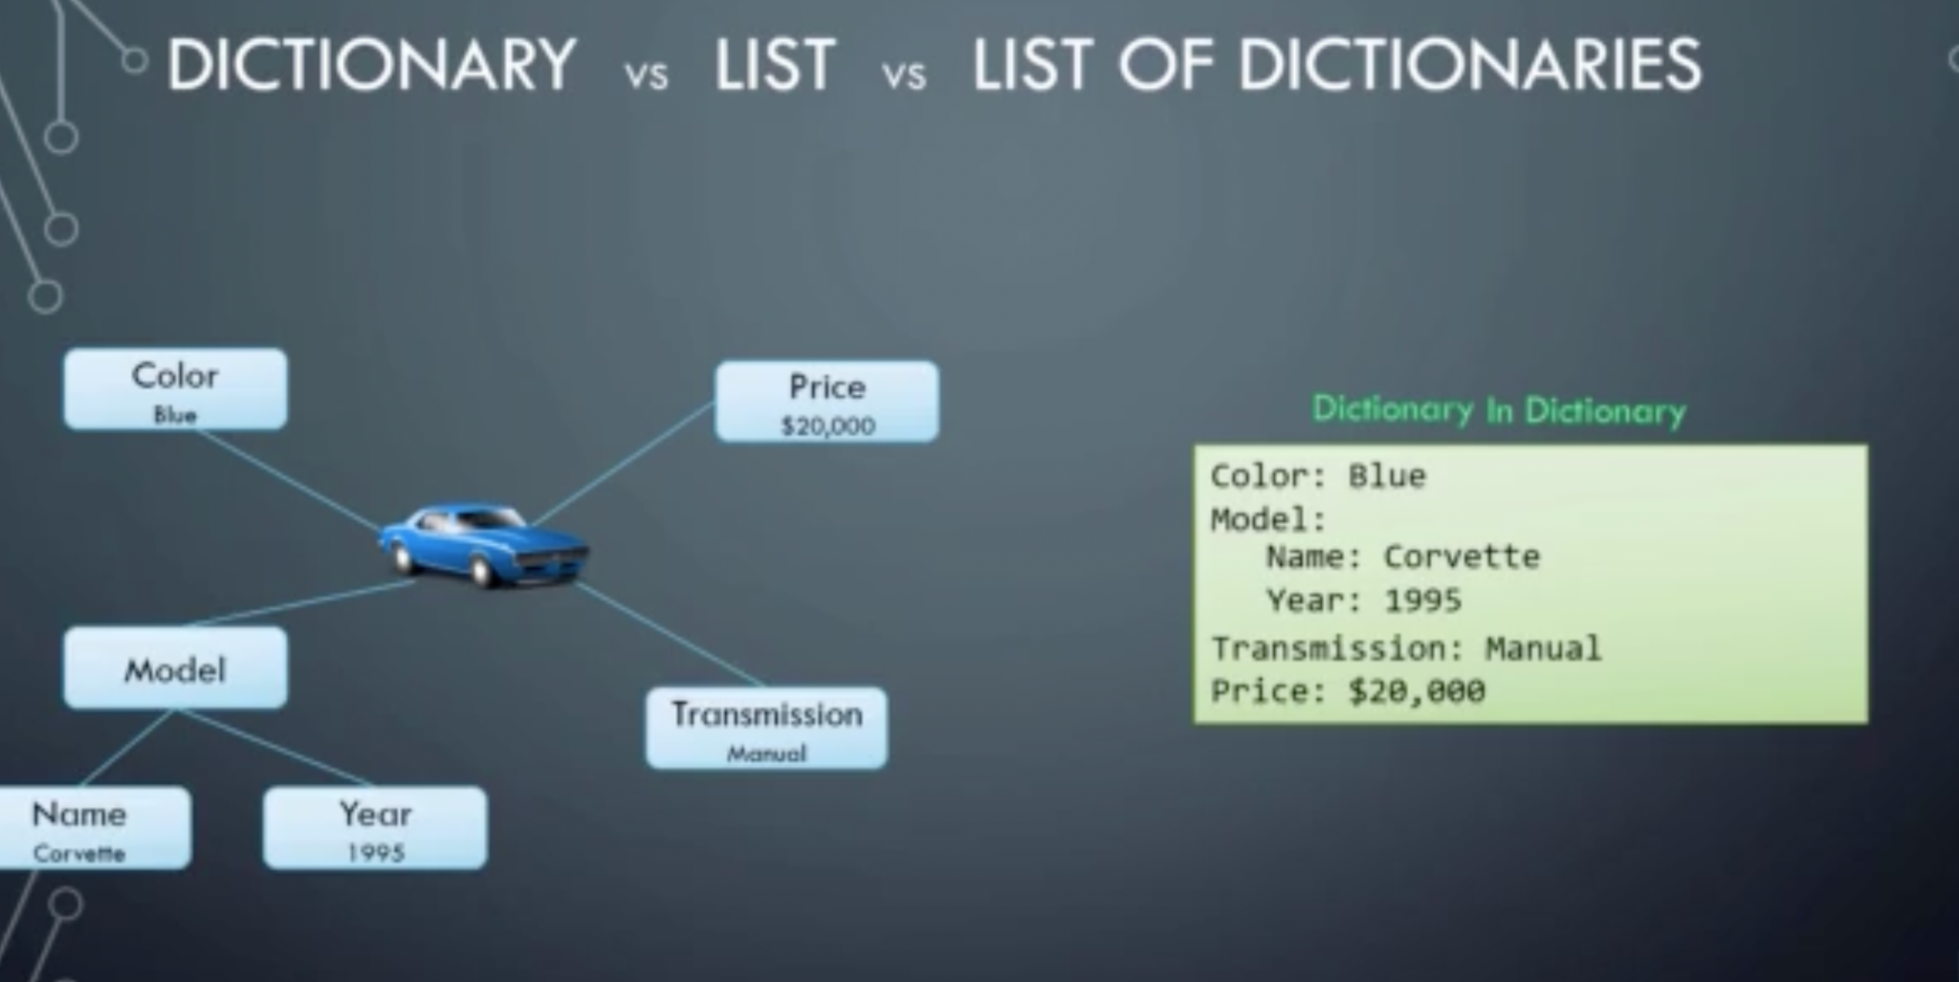

Slide 18
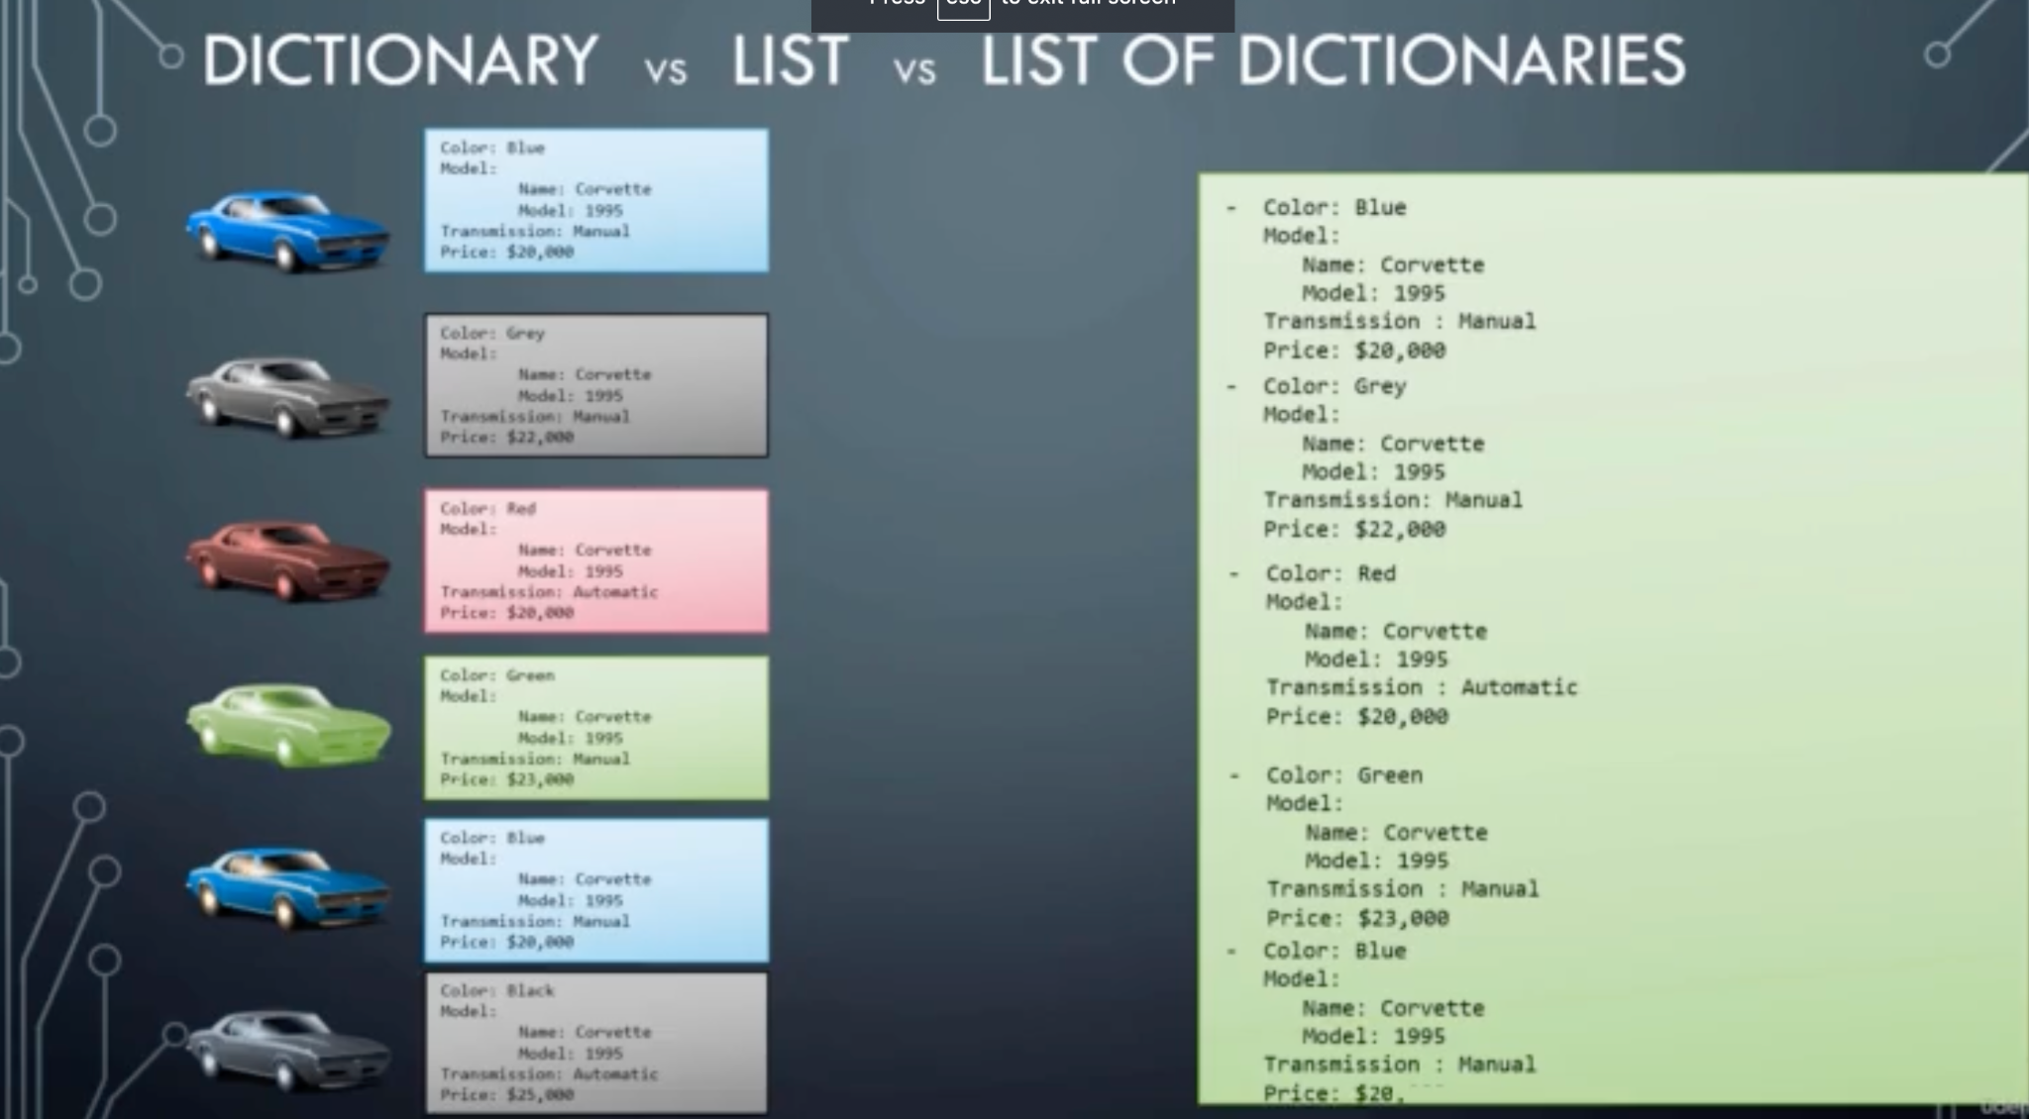

Slide 19
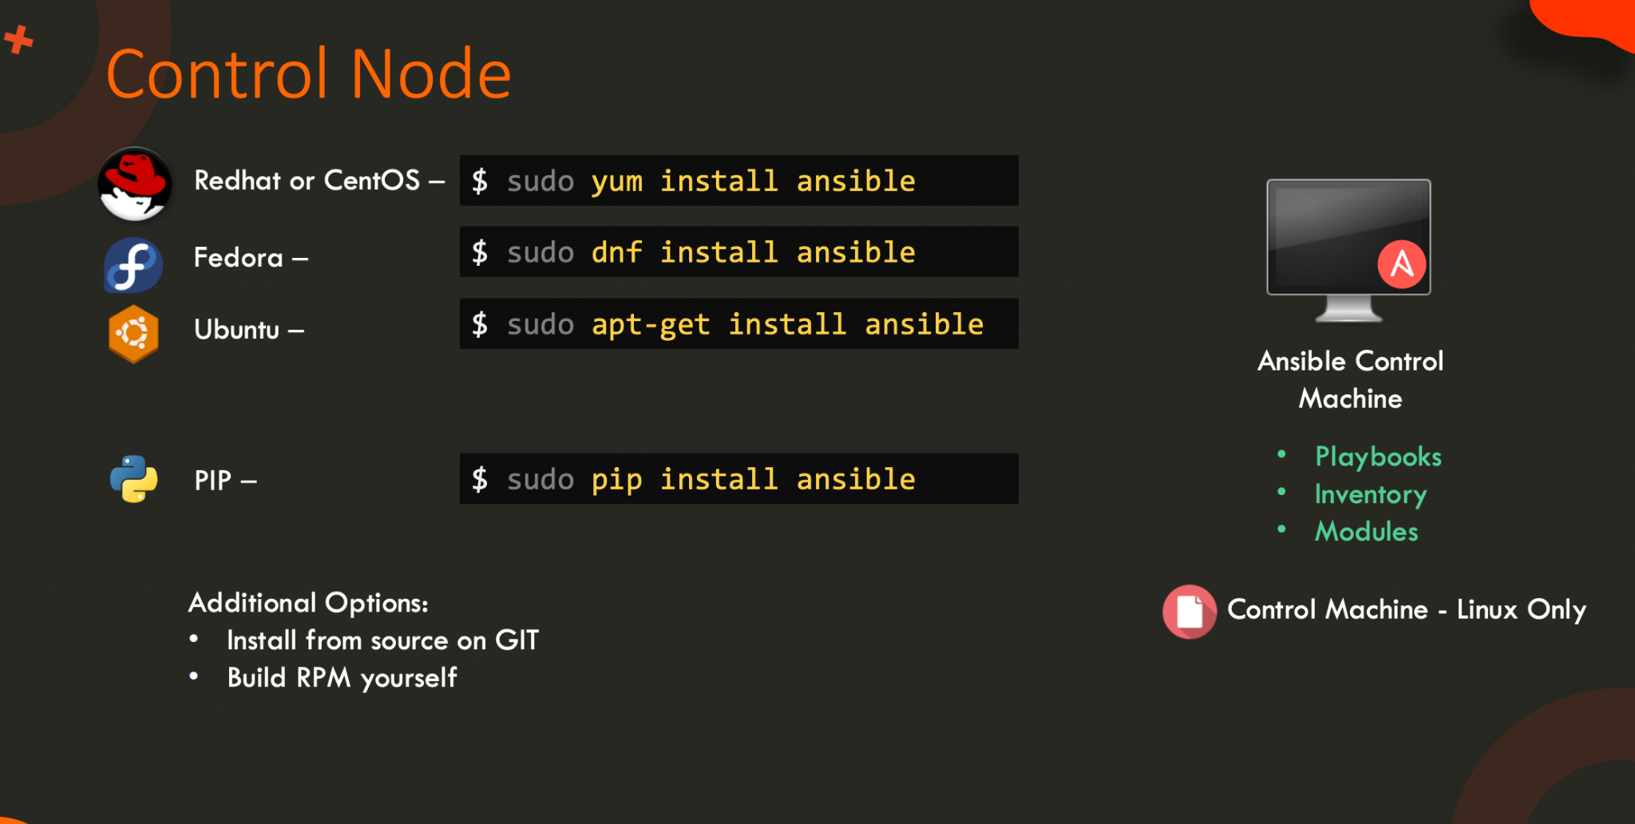

Slide 20


Slide 21
Which of the following is used to separate the key and value in YAML?
colon
comma
hyphen
semicolon

Slide 22
How many array keys are there in the following yaml snippet?
Fruits:
- Orange
- Apple
- Banana
Vegetables:
- Carrot
- CauliFlower
- Tomato

Slide 23
Which of the following statements is true?
A. Dictionary is an unordered collection whereas list is an ordered collection.
B. Dictionary is an ordered collection whereas list is an unordered collection.
C. Dictionary and list, both are an ordered collection.
D. Dictionary and list, both are an unordered collection.

Slide 24
practice.yaml
We have updated the /home/bob/playbooks/practice.yaml file with the key name and value apple. Add some additional properties (given below) to the dictionary.
name= apple color= red weight= 90g

Slide 25
Now, update the /home/bob/playbooks/practice.yaml file with a dictionary in dictionary.
Add a dictionary named address to add the address information in this file.
Key/Property Value
City edison
State new jersey
Country united states

Slide 26
We have updated the /home/bob/playbooks/practice.yaml file with an array of apples. Add a new apple to the list to make it a total of 4

Slide 27
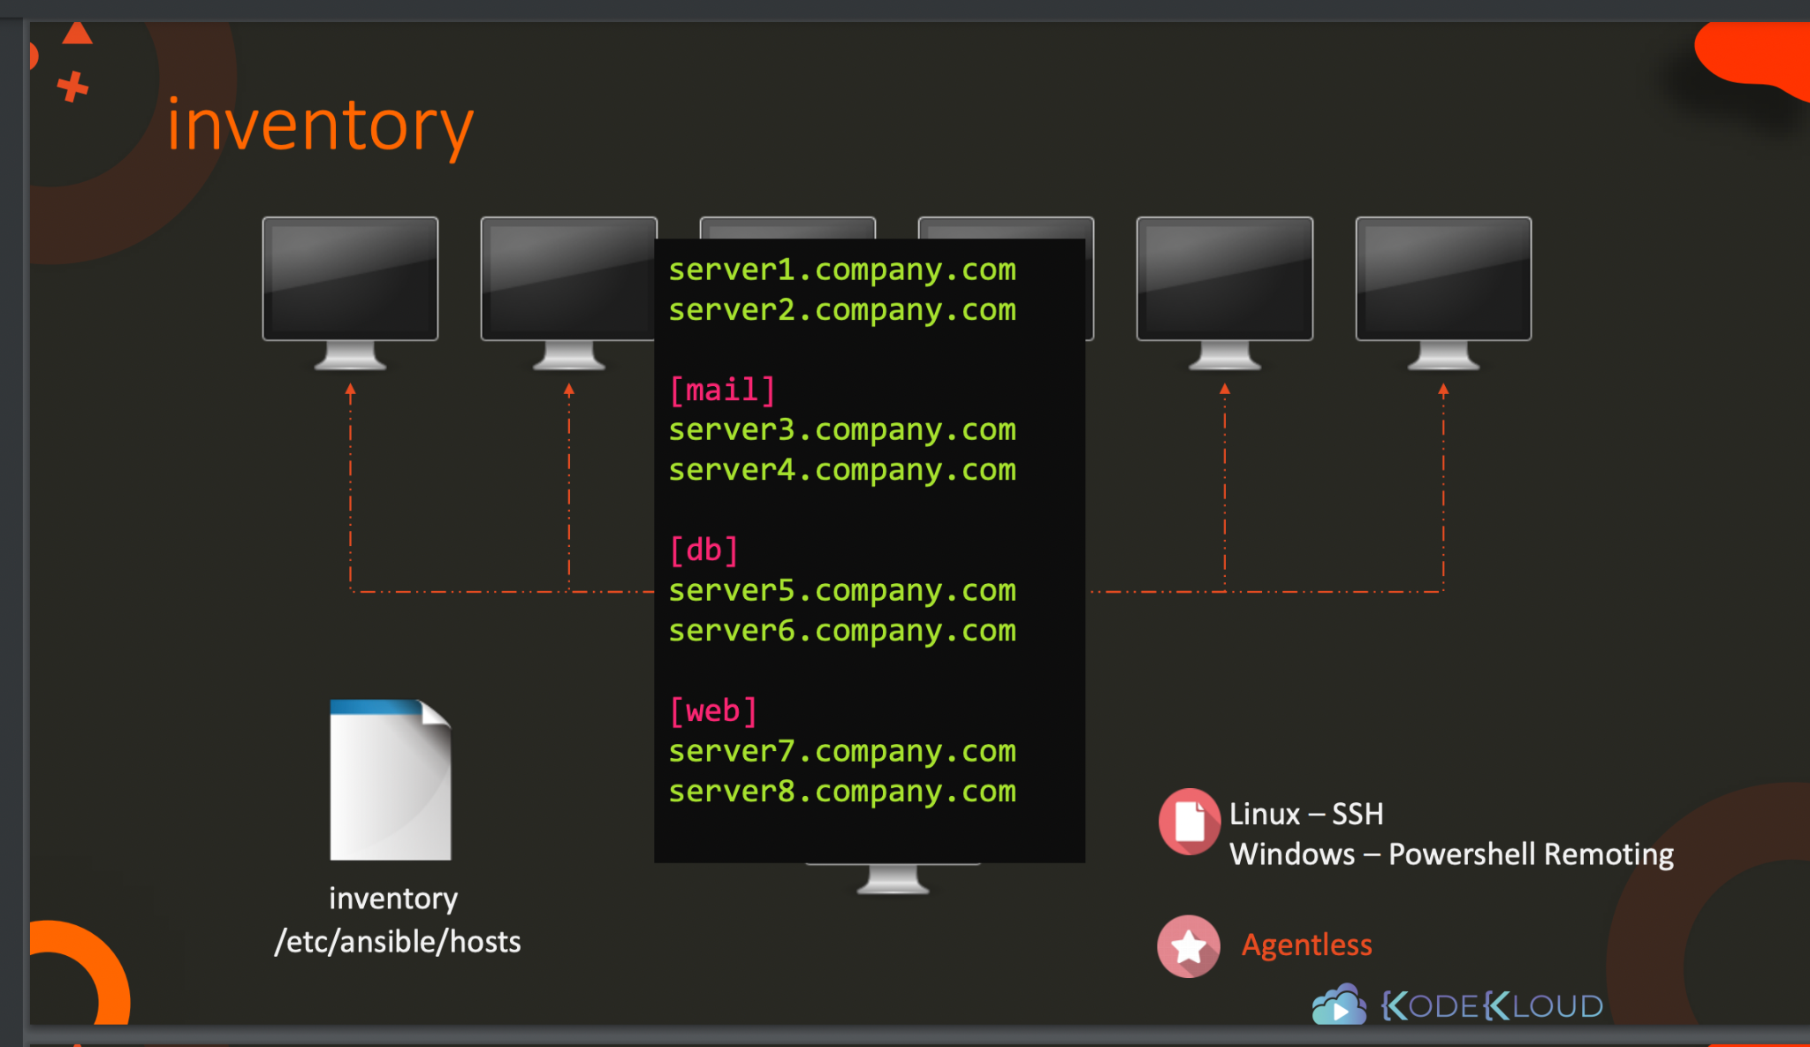
Inventory

Slide 28
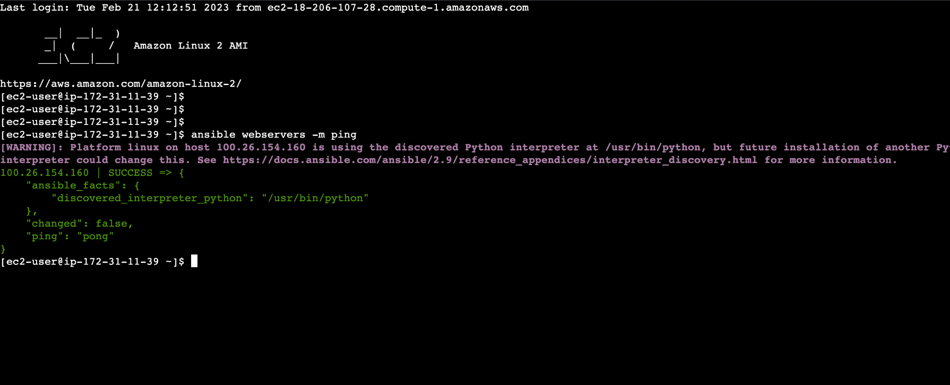

Slide 29
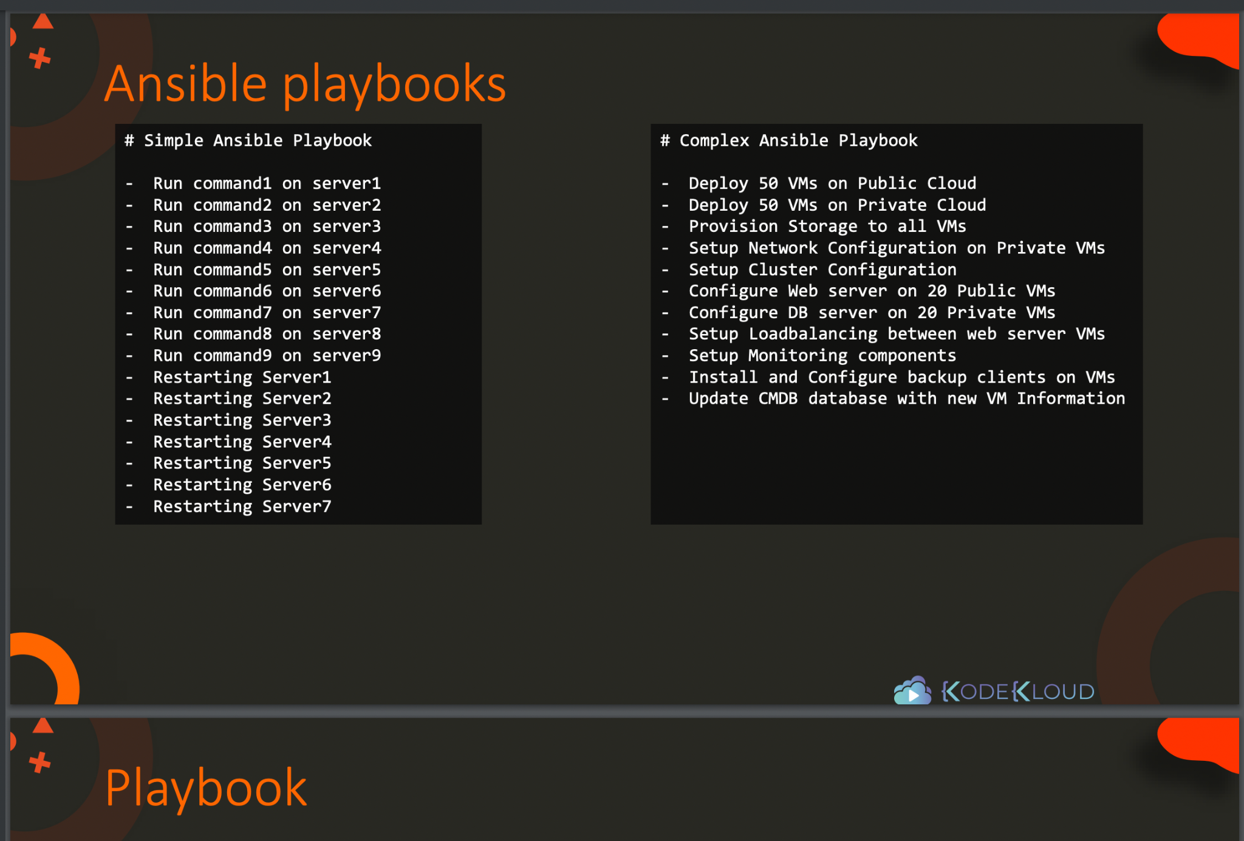

Slide 30
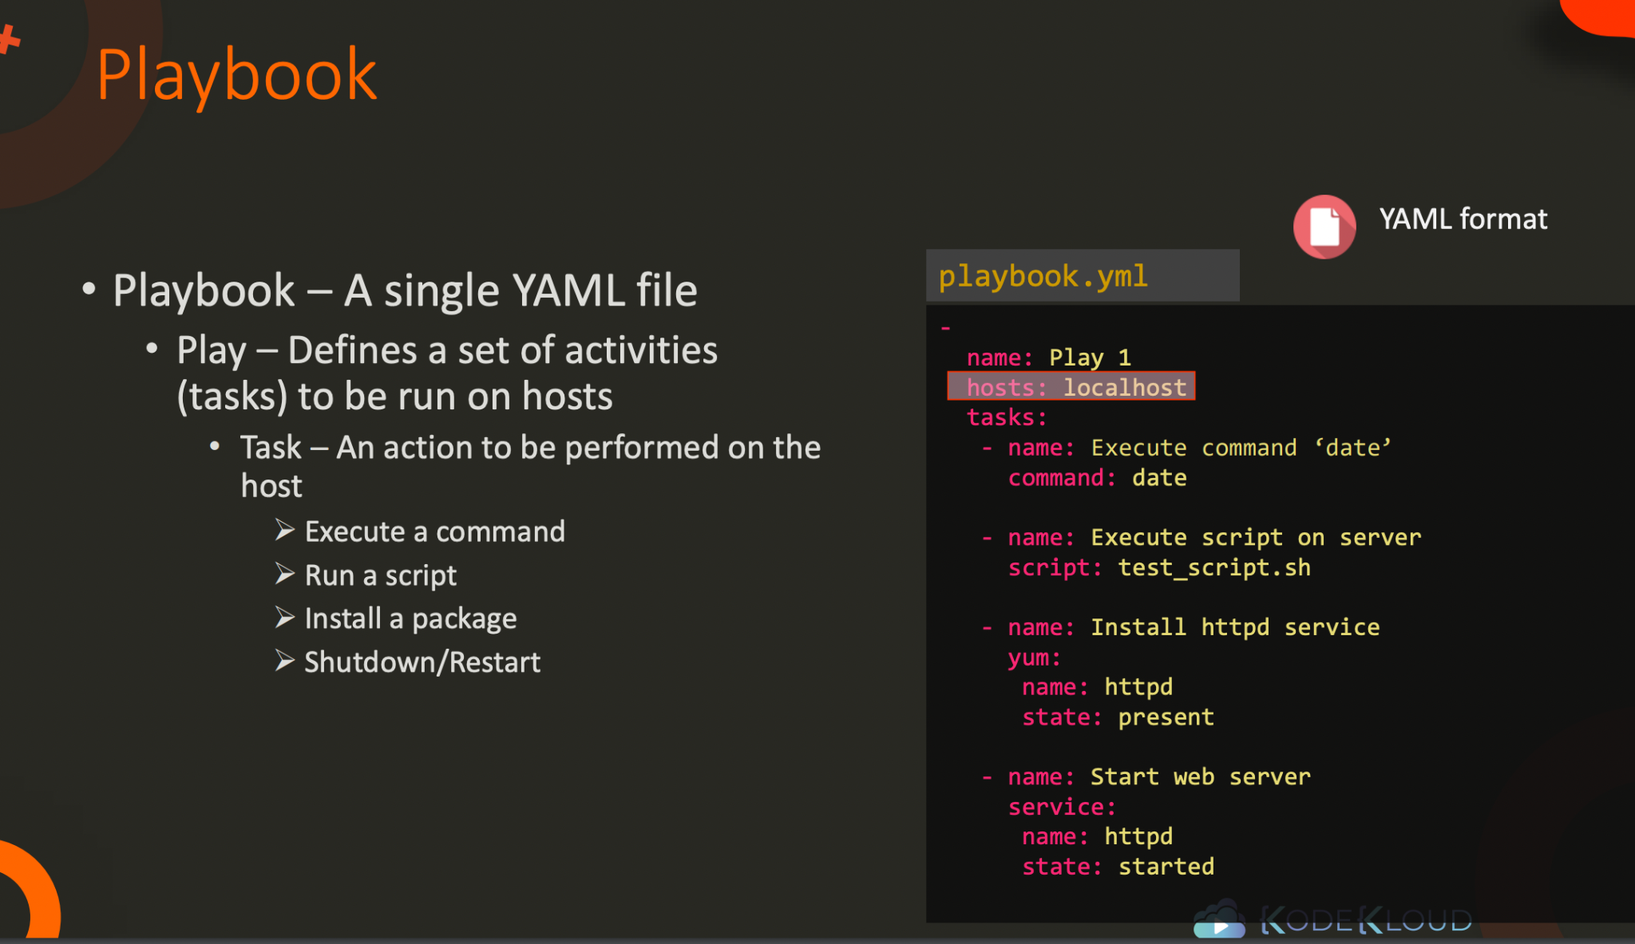

Slide 31
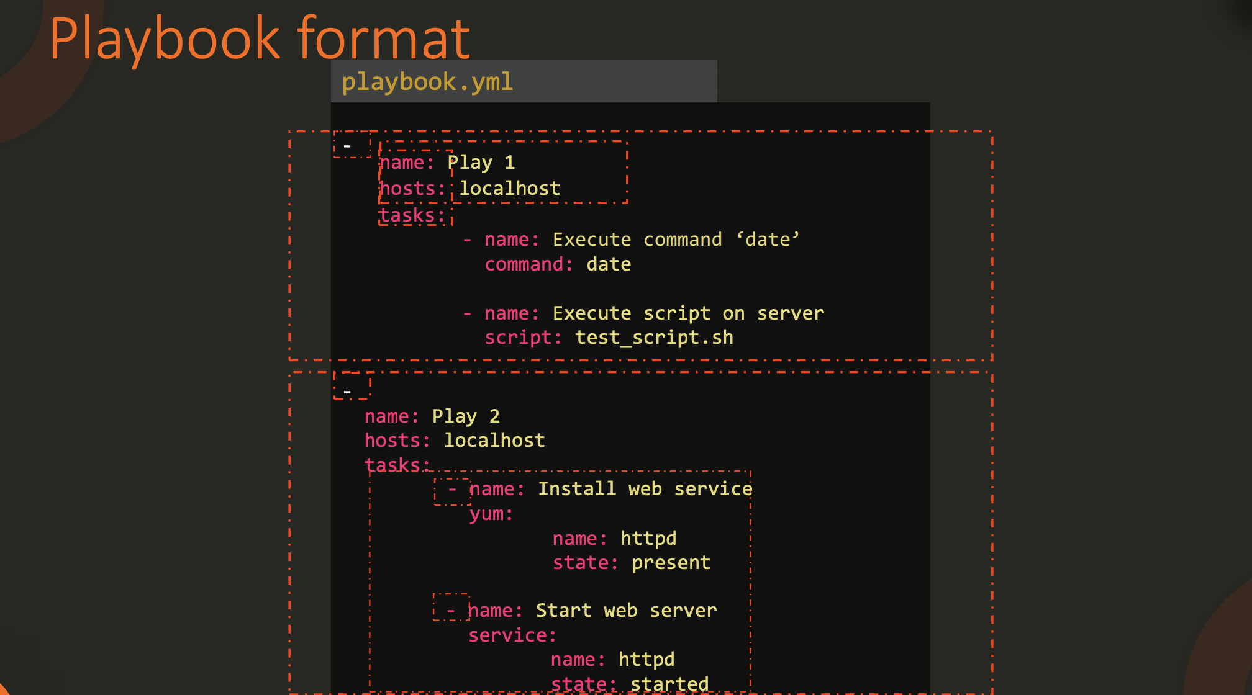

Slide 32
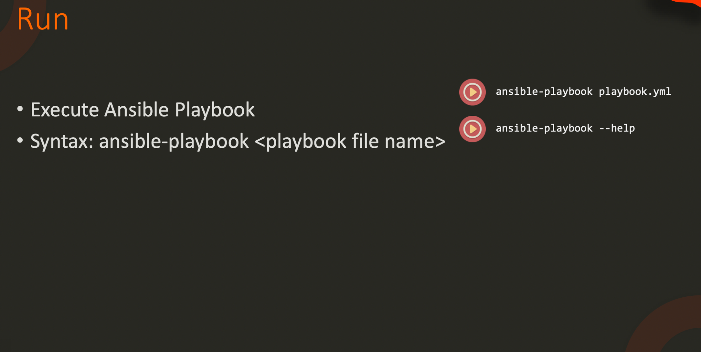

Slide 33
ansible all -m ping

Slide 34
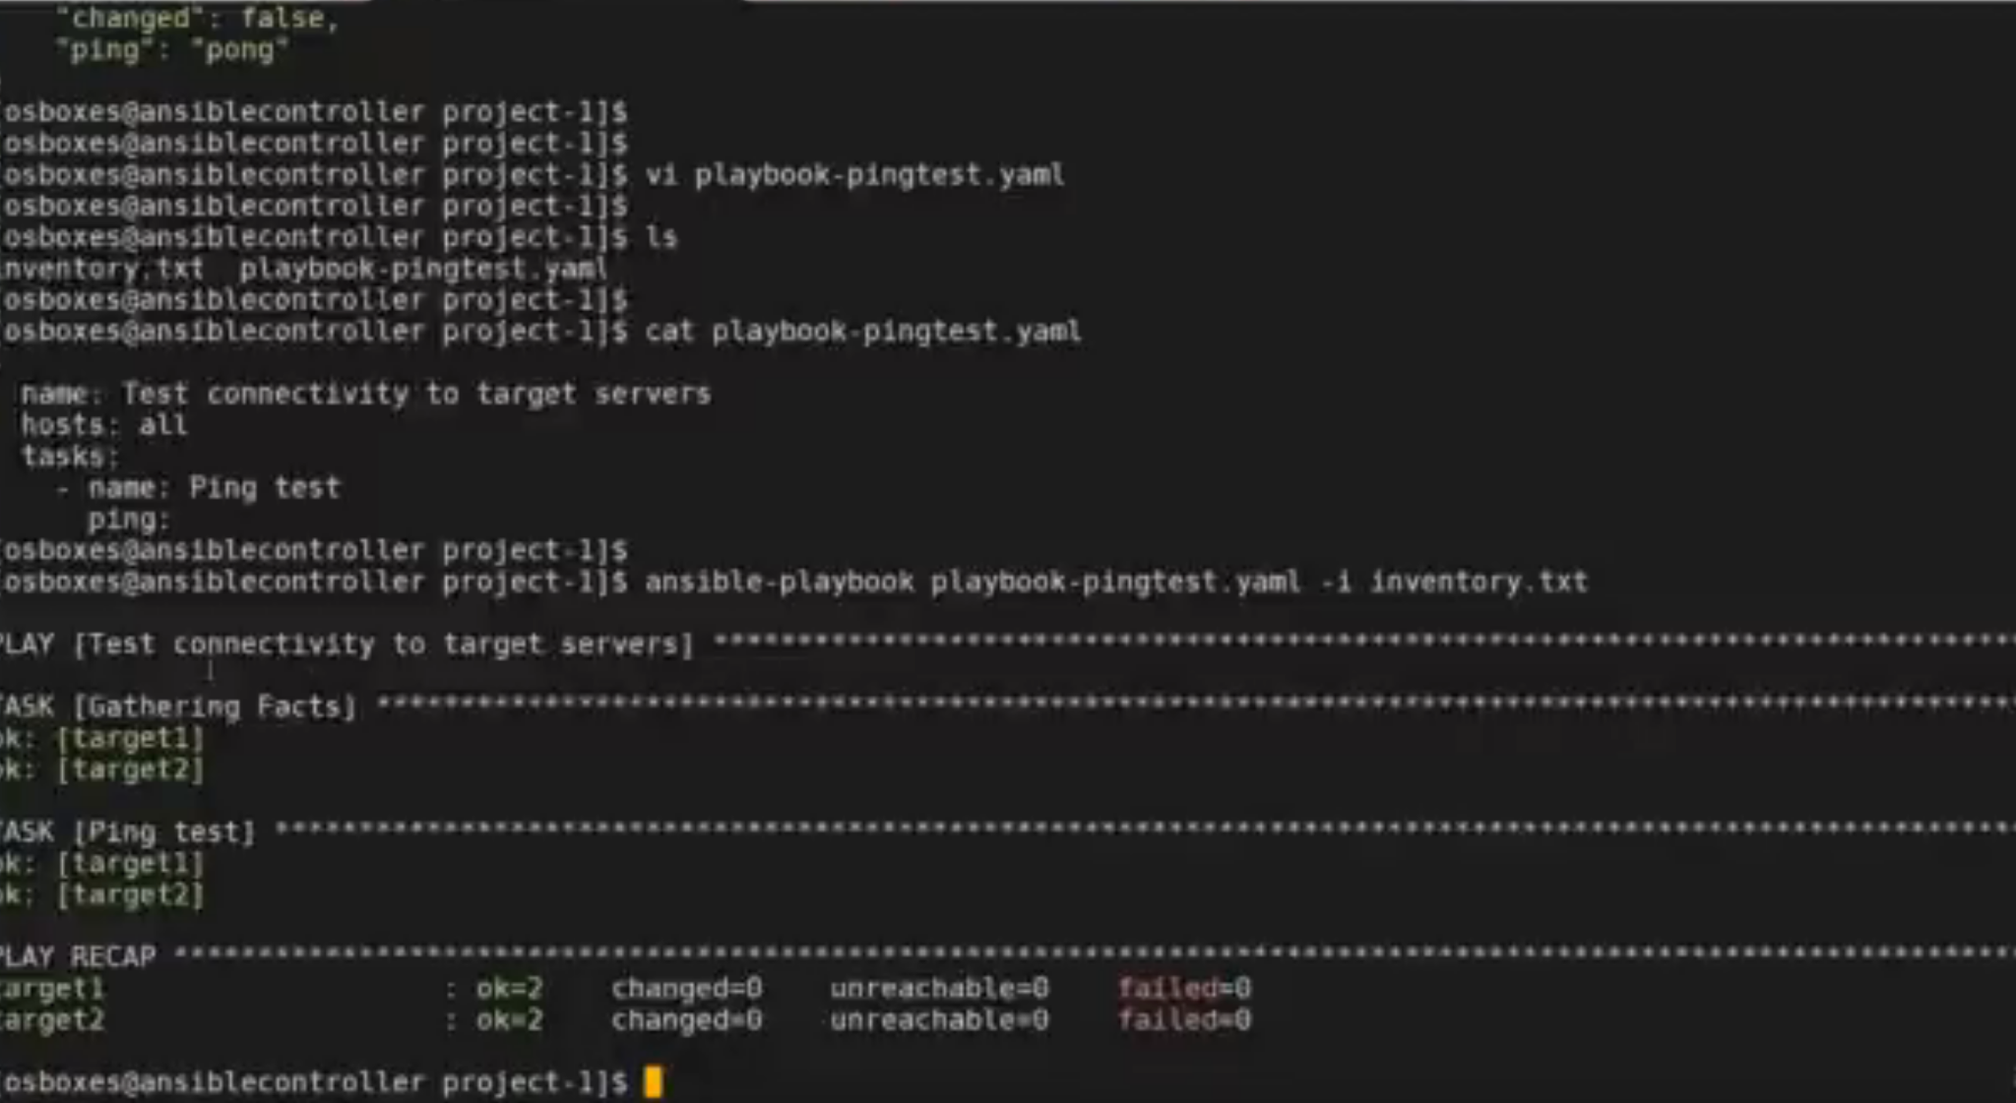

Slide 35
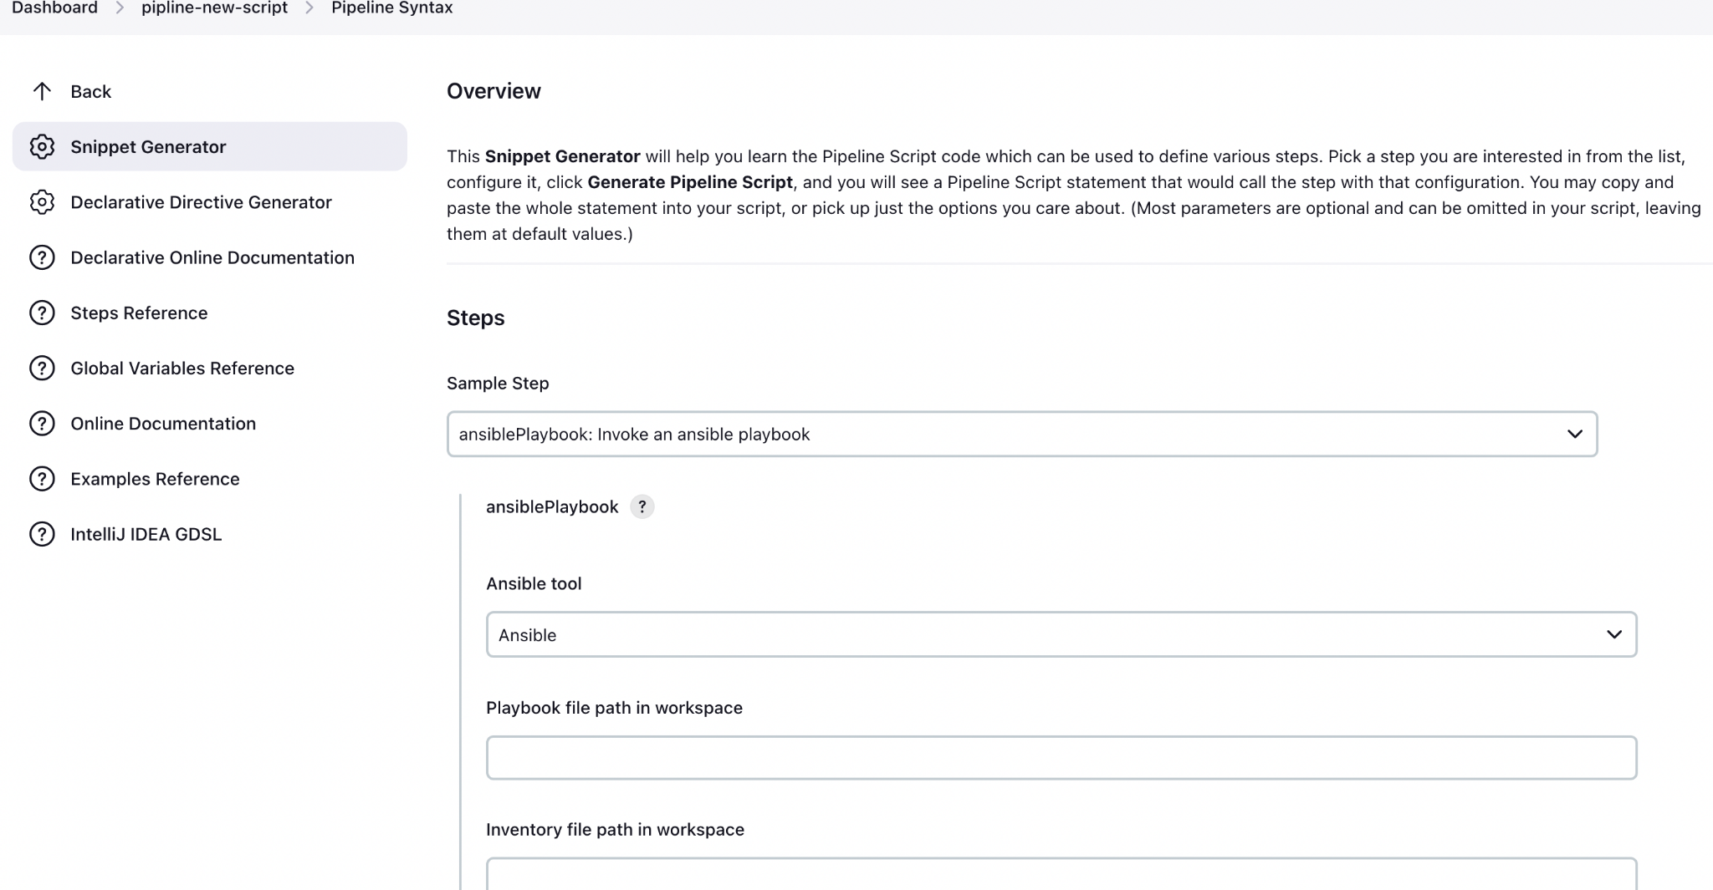

Slide 36
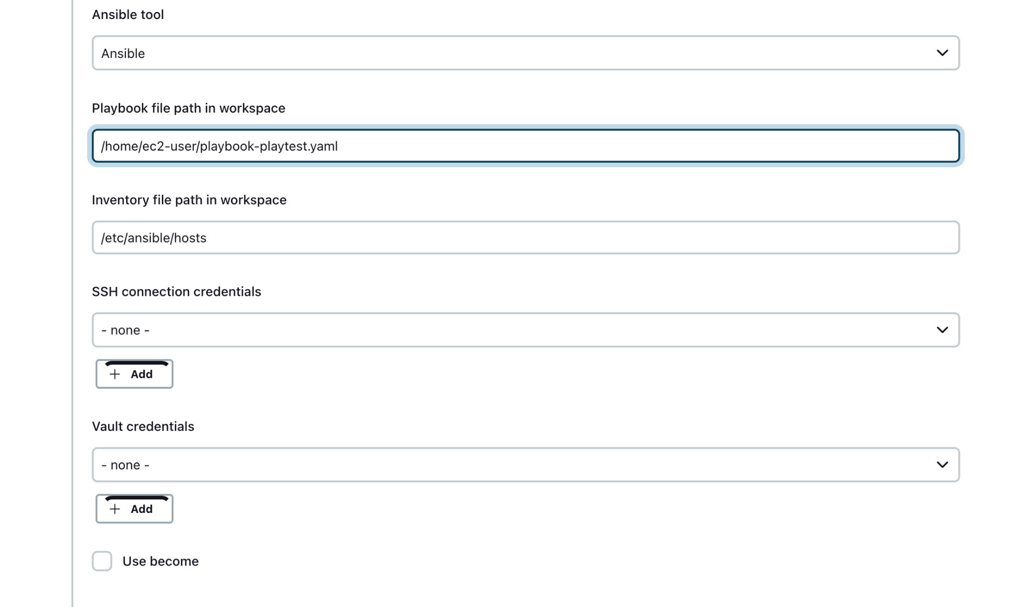

Slide 37
https://github.com/mariusv/ec2-ansible-jenkins

